Slide 1
Education and Outreach
Jordan Raddick
Bonnie Souter

Slide 2
Education and Outreach
How do we present ourselves to the world?
Researchers who want to use our data
Data providers
“Citizen scientists” interested in contributing to science
Students and teachers
The public
Goals
Build the best resources we can for researchers
Create meaningful learning experiences
Advocate for the importance of science

Slide 3
Includes…
Community outreach
Naming / branding / informational websites
Collaborations with other organizations
Informing the research community
Training
Helpdesk and other help systems
Workshops
User Feedback
Active methods (e.g. user advisory groups)
Site usage logging

Slide 4
Includes…
Public Outreach
Press / public information
Citizen science
Education
Learning activities for K-12 and college classes/labs
Student notebook for managing activities and data
Expanding existing astronomy learning activities
Develop new activities in new domains

Slide 5




Branding
Project name: SciServer
Echoes “SkyServer” with extensible brands (ideas):

Slide 6
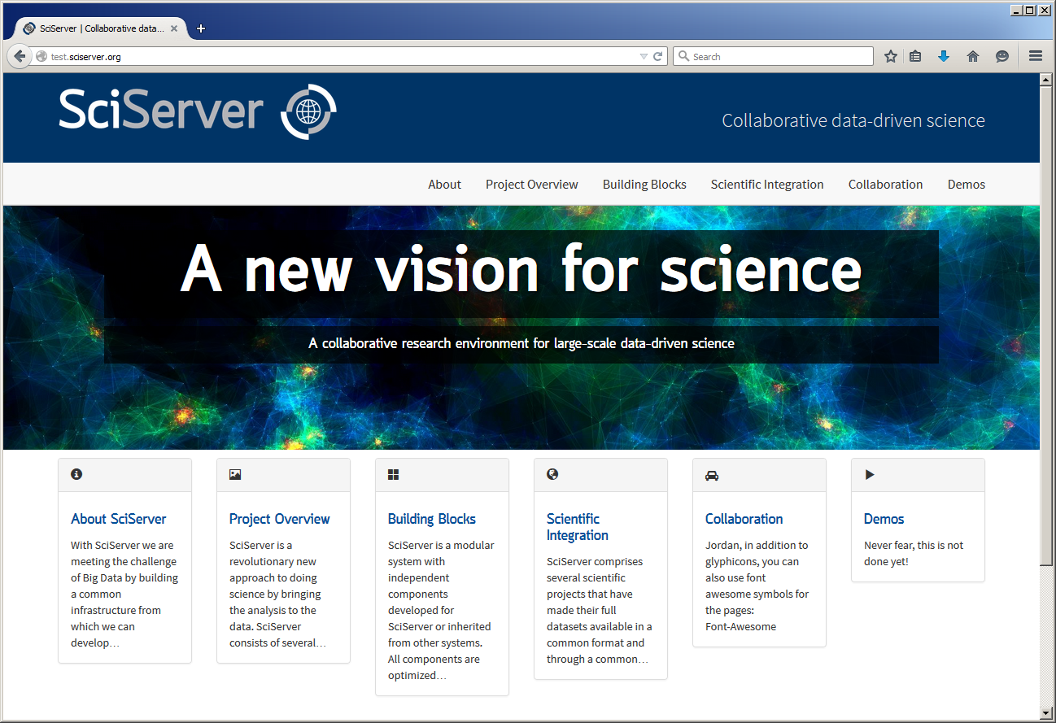
Website
NOTE: replace with final site screenshot!
Site demo? Active content?

Slide 7
Collaborations
DataOne
Discussing ideas for future webinar topics
Researching citizen science trends
Citizen Science Alliance / Zooniverse.org
Institutional member (JHU) with board rep (Raddick)
Other DIBBs collaborations
Initial meeting, further discussions

Slide 8
Collaborations
DataNet DFC: GET info from Mike/Alex!
NCSA: GET info from Alex!
San Diego Supercomputer Center
Open Stack infrastructure for SciDrive
Swift support for distributed clustering
Sharing virtual machines with Nova
Possible 100 Gig line?

Slide 9
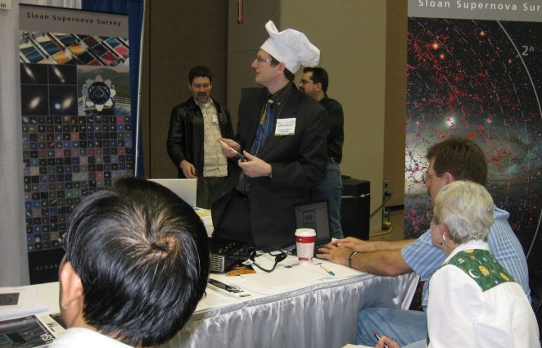
Meetings
PI (Szalay) discussed in 21 talks in 2013-14
Outreach director (Raddick) led trainings at astronomy meetings
“Cooking with Sloan”

Slide 10
Meetings
(maybe add some society logos for visuals?)
Plans to attend science domain and big data computing conferences
Ecological Society of America (Baltimore, April 2015)
Open Data Science Conference (Boston, May 2015)
SciPy workshop (Austin, July 2015)
SC 2015 (Austin, November 2015)
American Astronomical Society (Orlando, Jan. 2016)
And more being planned…

Slide 11
User Feedback
User Advisory Group
Currently IDIES faculty and students
Plan to expand to external researchers in 2016
Advisory Board: GET info from Alex!
Planning for active feedback on sites
Feedback forms, surveys, etc.
We will seek IRB approval through JHU as needed

Slide 12
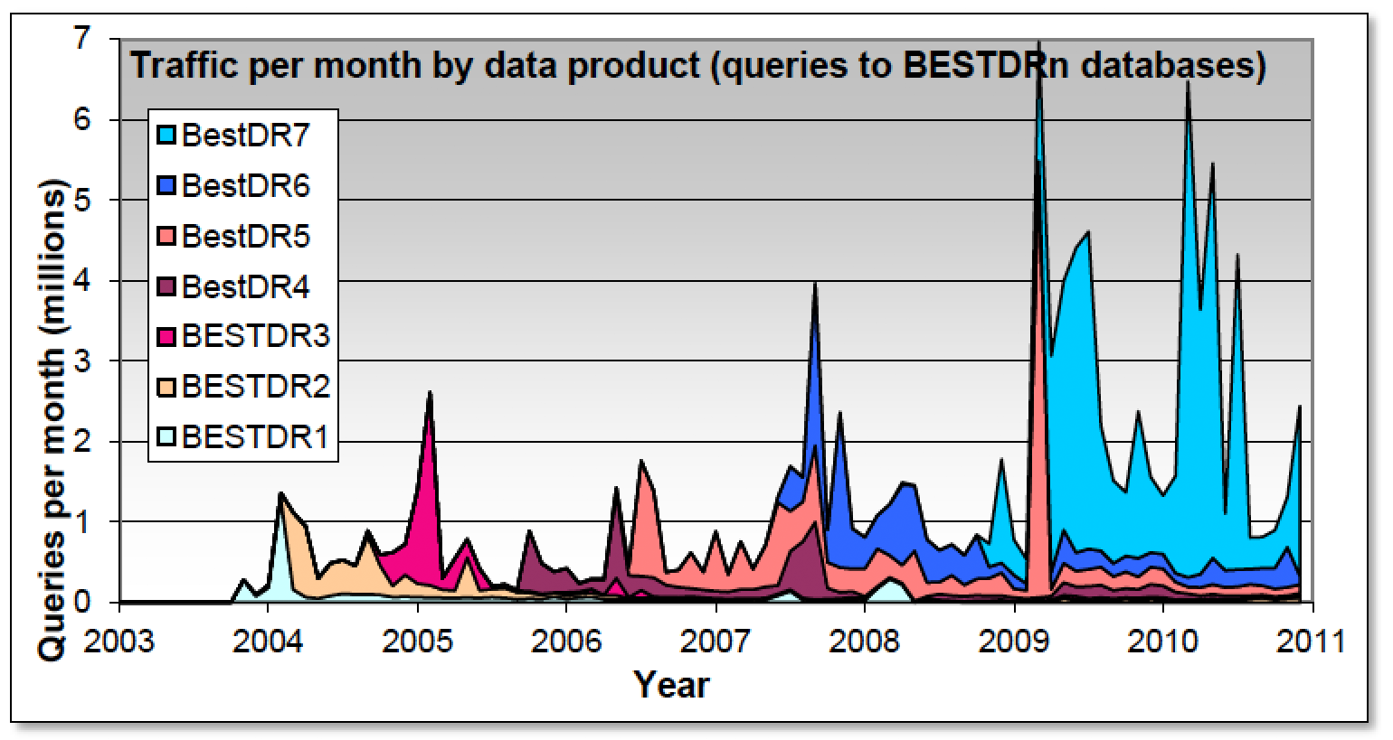
User Feedback: Logging
Normalized and studied SkyServer usage logs
Two papers in CiSE “Extreme Data” special issue (Raddick et al. 2014a, 2014b)
Data available in CasJobs

Slide 13
User Feedback: Logging
Next steps with SkyServer
Parse SQL queries into templates
Compare tool-generated and user-written queries
Watch how users learn SQL in (retrospective) real time!!!
Supplemented by Google Analytics data

Slide 14
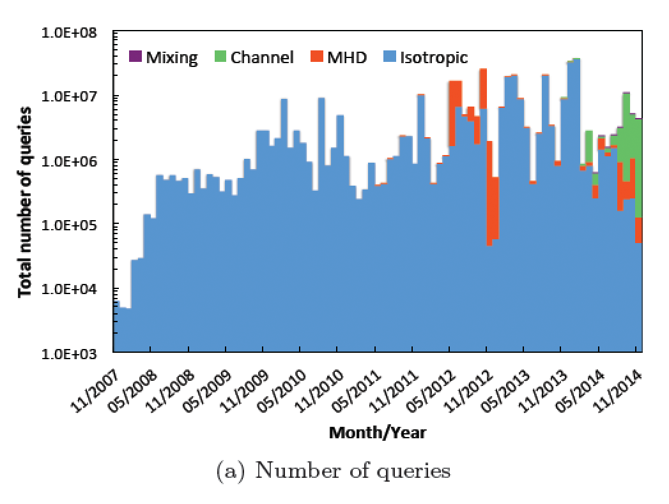
User Feedback: Logging
Writing paper about JHU Turbulence DB
(Kanov, Burns, Lalescu & Eyink in prep.)
Hits and queries logged for all future sites

Slide 15
Press and Public Information
Working with JHU Press Office as needed
Phil Sneiderman
Article for NSF web site
“SciServer: Big Data infrastructure for science,” Discoveries, 12/4/2014

Slide 16
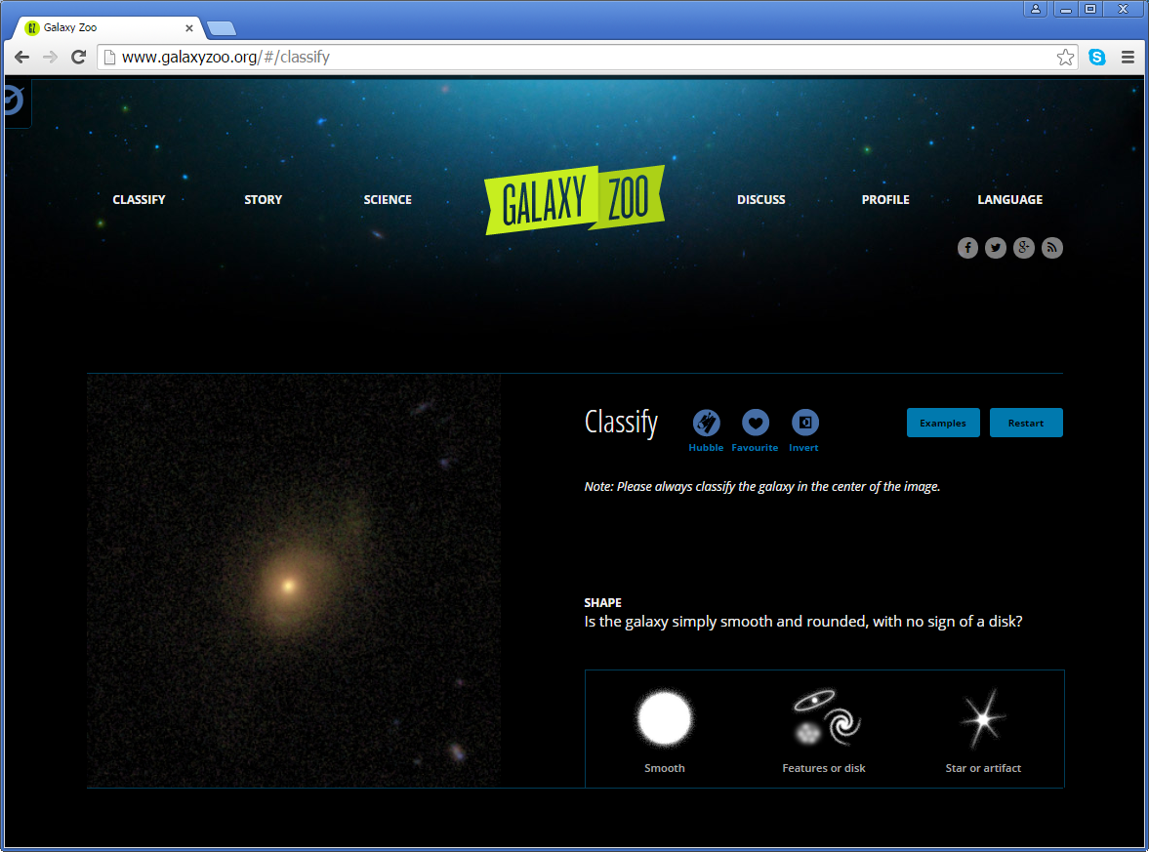
Citizen Science: Galaxy Zoo
SDSS data used in Galaxy Zoo
Studying user motivation and learning
Raddick et al. 2014
Prather et al. 2014

Slide 17
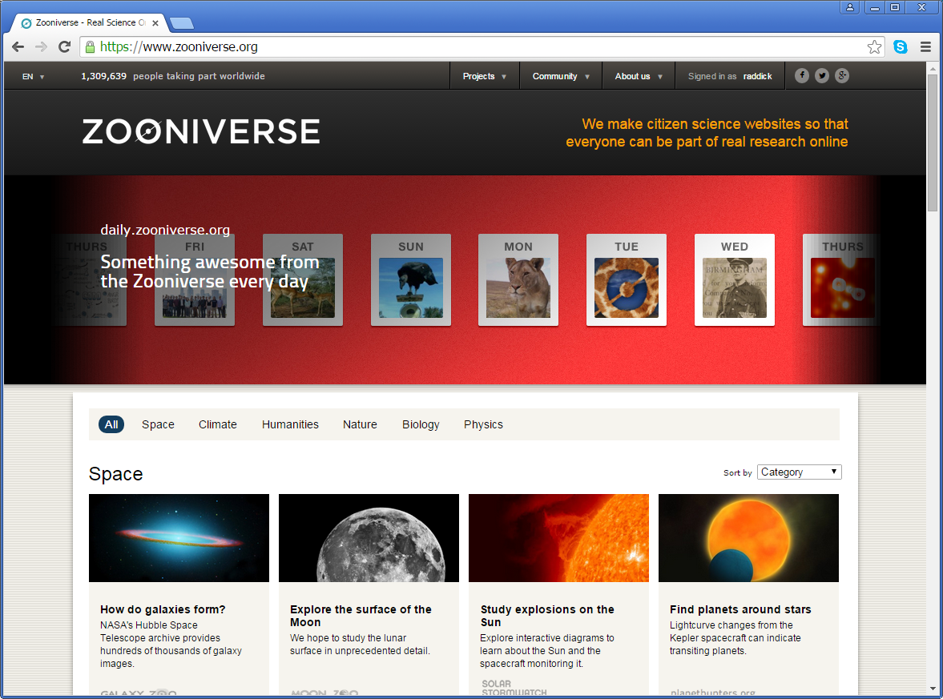
Citizen Science: Zooniverse
Zooniverse.org citizen science projects
Currently 28!
More than 1.3 million volunteers
Managed by Citizen Science Alliance
JHU is a founding member

Slide 18
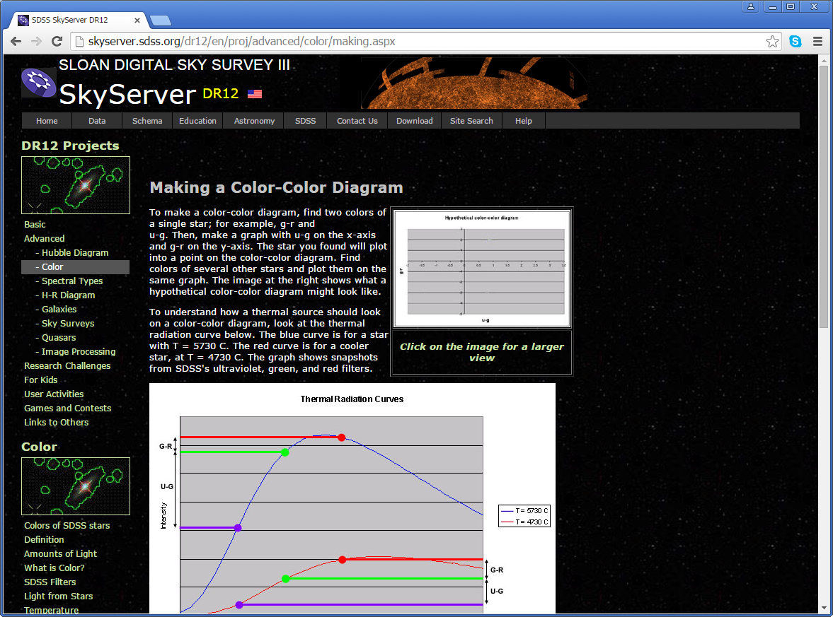
Formal Education Activities
Existing SkyServer education activities
Elementary to graduate schools
Use SDSS data
Insert usage stats
Continue to maintain and enhance

Slide 19
Student Notebook
Main development activity
Instructors log in through portal
Identify themselves in account settings
Create associated logins for their students
Student interactions always through teachers, ensuring student safety

Slide 20
Notebook: Components
My Sky: save objects found in browsing
MyDB backend, but teachers and students interact only with simpler notebook interface
My Data: all query results (including form-based searches) saved in separate tables
Instructors have same query limits as any other user
Students too, but their data are cleared after 30 days unless they convert to regular user accounts

Slide 21
Notebook: Components
My Notebook: Student answers to questions and exercises also recorded in MyDB
Teachers can view, grade, leave feedback

Slide 22
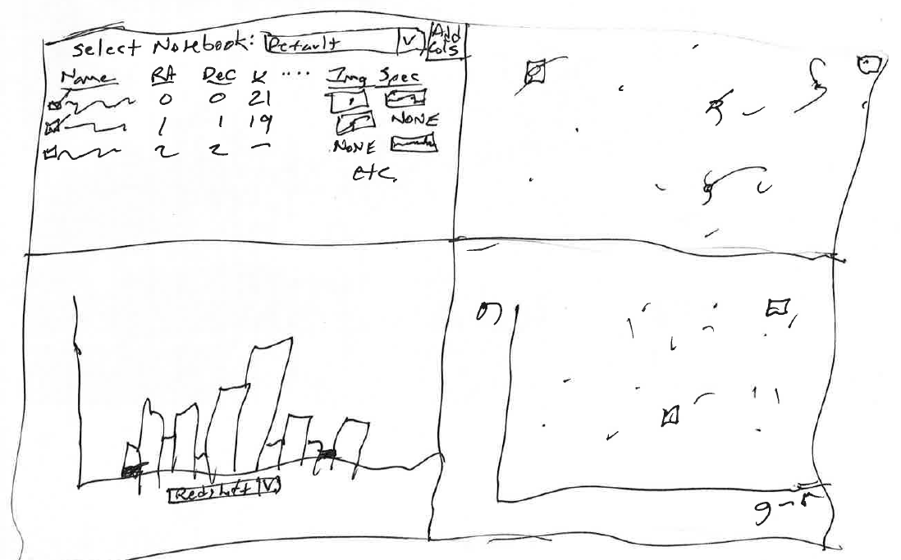
Notebook: Progress
Underlying technologies nearly complete
Preliminary design drawings
With HS sci teacher (Kate Meredith)
Next step: detailed use cases

Slide 23
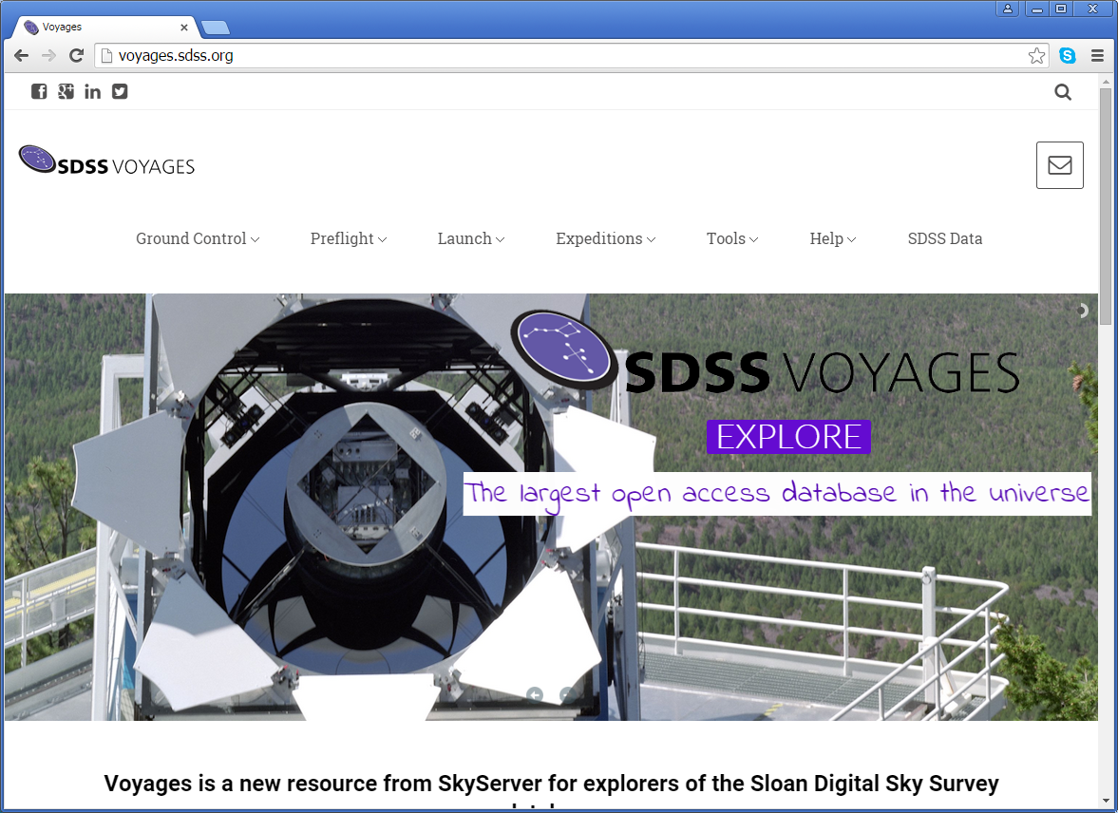
Notebook: SDSS Voyages
To be integrated into updated SDSS lessons

Slide 24
Notebook: Future Plans
Astronomy integration by 3-year review
Build out to other science areas
Further develop MyNotebook capabilities

Slide 25
References
Raddick, M. J., Thakar, A. R., Szalay, A. S., & Santos, R. D. C. 2014, “Ten Years of SkyServer I: Tracking Web and SQL e-Science Usage,” Computing in Science and Engineering, 16(4), 22
Raddick, M. J., Thakar, A. R., Szalay, A. S., & Santos, R. D. C. 2014, “Ten Years of SkyServer II: How Astronomers and the Public Have Embraced e-Science,” Computing in Science and Engineering, 16(4), 32

Slide 26
References
Raddick, M. J., Bracey, G., Gay, P. L., Lintott, C. J., Cardamone, C., Murray, P., Schawinski, K., Szalay, A. S., & Vandenberg, J. 2014, “Galaxy Zoo: Motivations of Citizen Scientists,” Astronomy Education Review, 12, 010106
Prather E. E., Cormier, S., Wallace, C. S., Lintott, C. J., Raddick, M. J., & Smith, A. 2014, “Measuring the Conceptual Understandings of Citizen Scientists Participating in Zooniverse Projects: A First Approach,” Astronomy Education Review, 12, 010109

Slide 27
References
“SciServer: Big Data infrastructure for science,” Discoveries, 12/4/2014
http://www.nsf.gov/discoveries/disc_summ.jsp?cntn_id=133526&

